Slide 1
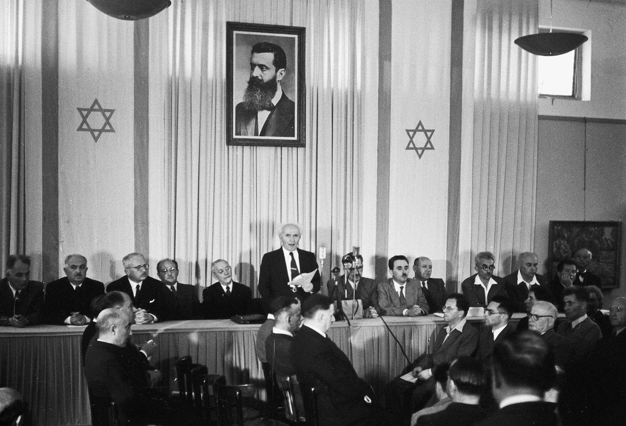
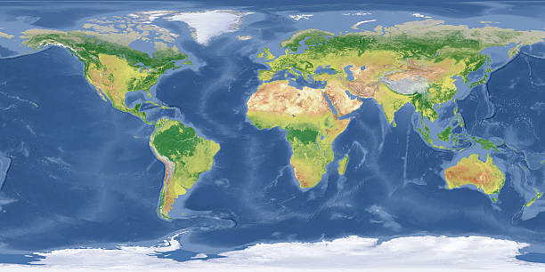
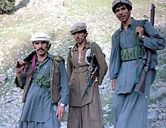
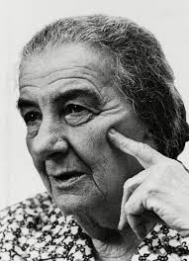
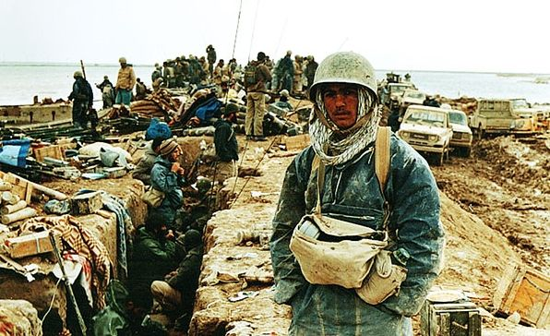
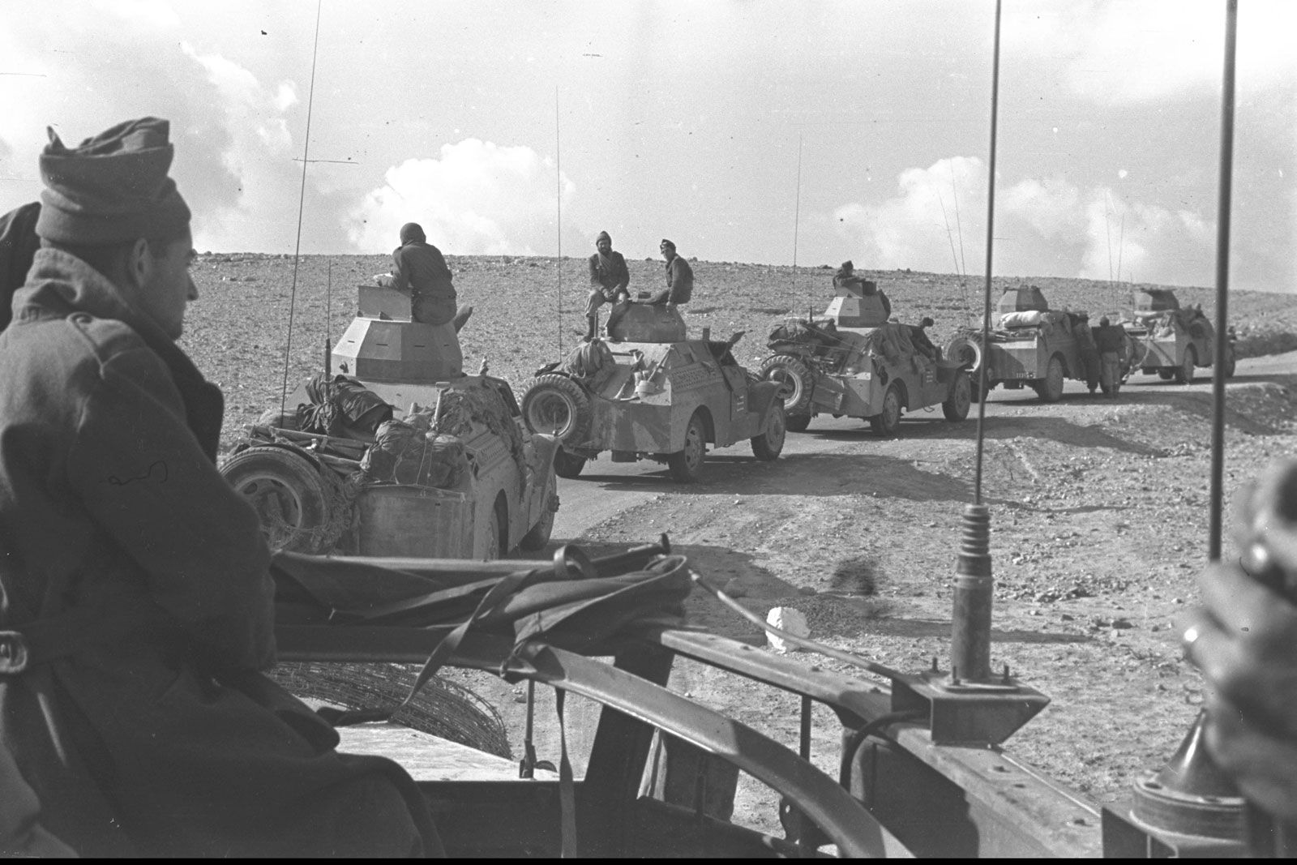
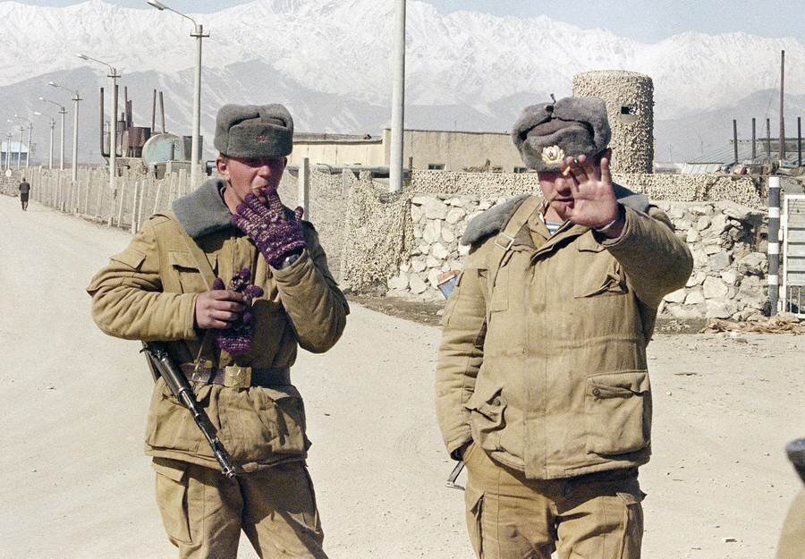
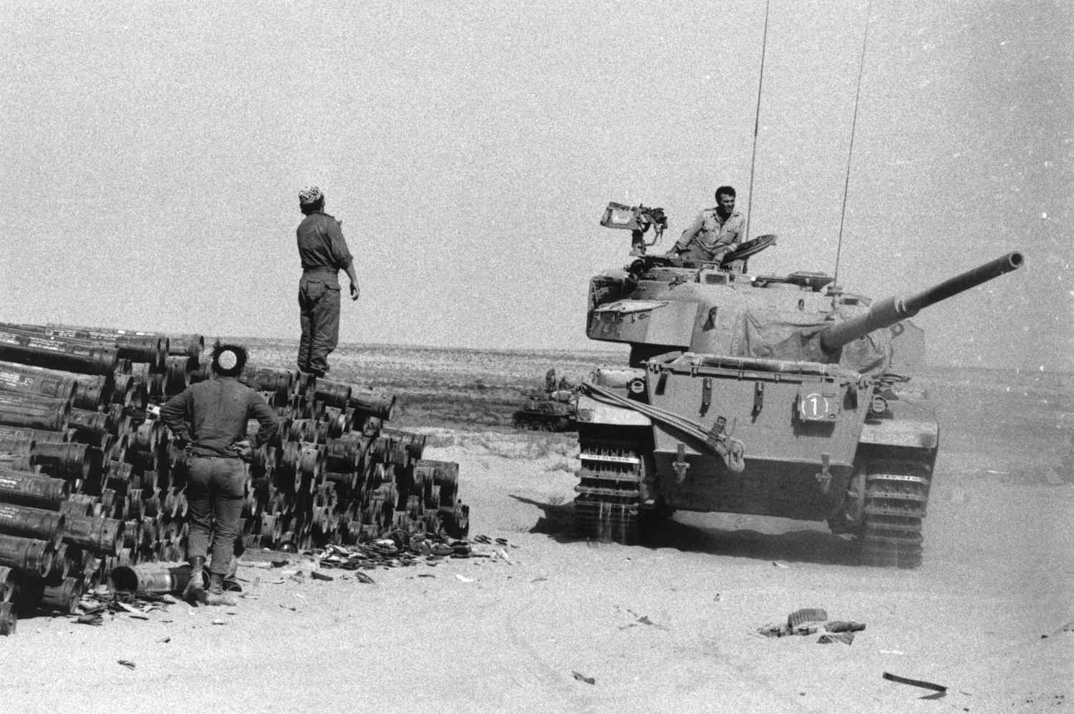
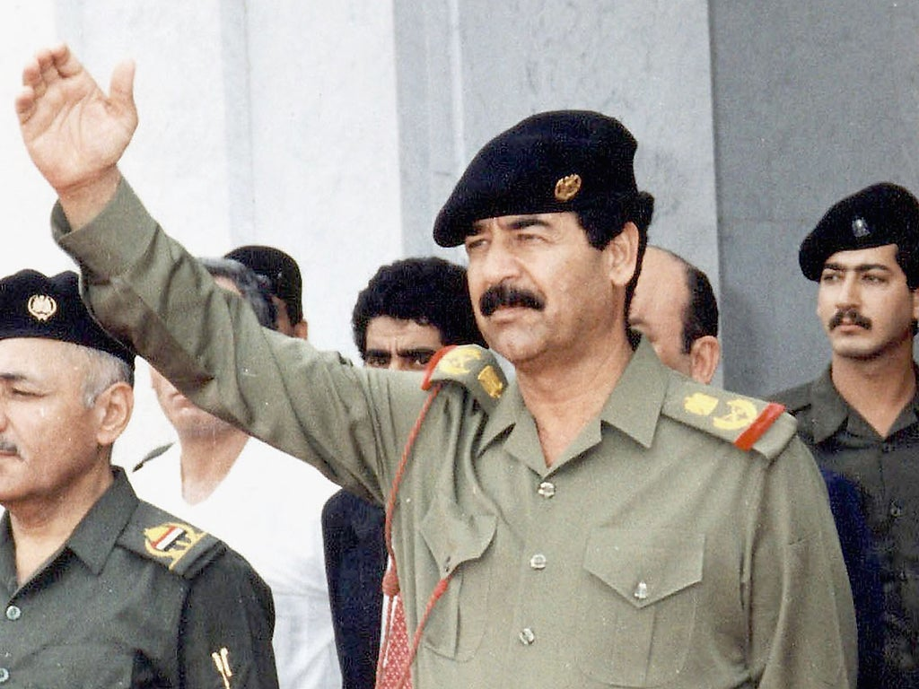
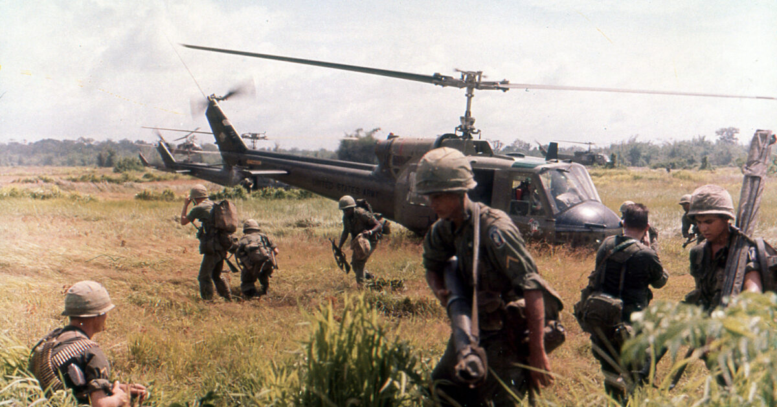
Lesson 4: Regional Conflicts and Their Global Impact
Notes:
Instructor Notes: Verbatim Guidance: "Let’s begin by thinking about why conflicts start. Are they always about land or power? Can small regional issues affect the whole world?"
Background Information: This prepares students to view regional conflicts within the larger Cold War and post-Cold War contexts.
Structure Mapping: Introduction

Slide 2



Learning Objectives
Understand major regional conflicts during the Cold War.
Explore causes and consequences of these conflicts.
Analyze global responses and peace efforts.
Connect lessons to Islamic values of justice and peace.
Notes:
Instructor Notes: Verbatim Guidance: "Today, we’ll examine key regional conflicts and how they impacted the world. We’ll also reflect on how Islamic teachings promote justice and unity during conflict."
Structure Mapping: Learning Objectives

Slide 3
The Arab-Israeli Conflict
Rooted in land claims and historical grievances
1948: Israel declared; led to wars and displacement
Peace efforts: Camp David, Oslo, recent normalization
Notes:
Instructor Notes: Verbatim Guidance: "The Arab-Israeli conflict is a major regional issue with roots in colonial history, displacement, and competing claims. Despite challenges, efforts toward peace continue."
Discussion Prompts:
What are some obstacles to resolving this conflict?
How does displacement affect generations?
Anticipated Questions: "What are the Oslo Accords? Why is Jerusalem controversial?"
Structure Mapping: Presentation of New Content

Slide 4

The Iran-Iraq War (1980–1988)
How should countries resolve disputes peacefully?
Began over border disputes (Shatt al-Arab)
Saddam feared Iran’s post-revolution influence
War caused over a million casualties
Ended in stalemate with massive destruction
Notes:
Instructor Notes: Verbatim Guidance: "This devastating war between neighbors reshaped the Middle East. It was fueled by fear, ideology, and territorial rivalry."
Discussion Prompts:
How should countries resolve disputes peacefully?
What were the global effects of oil disruption?
Structure Mapping: Presentation of New Content

Slide 5
The Soviet-Afghan War (1979–1989)
USSR invaded to support communist Afghan government
Mujahideen resisted with support from US, Saudi Arabia, Pakistan
War weakened Soviet economy, led to USSR collapse
Massive Afghan displacement
Notes:
Instructor Notes: Verbatim Guidance: "Afghans defended their homeland and faith against foreign occupation. Their resilience became symbolic across the Muslim world."
Discussion Prompts:
What does jihad mean in this context?
How did this conflict affect global power dynamics?
Structure Mapping: Presentation of New Content

Slide 6
The Gulf War (1990–1991)
Iraq invaded Kuwait over oil and territory claims
Global coalition, including Saudi Arabia, intervened
Operation Desert Storm liberated Kuwait
War highlighted Islamic unity and justice
Notes:
Instructor Notes: Verbatim Guidance: "When Kuwait was invaded, many countries, including Muslim-majority nations, defended its sovereignty. This showed the value of unity and justice in Islam."
Discussion Prompts:
Why is it important to defend neighboring nations?
What role did Saudi Arabia play?
Structure Mapping: Presentation of New Content

Slide 7
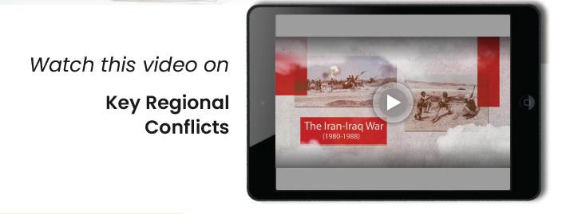
Notes:
Link: https://learn.kodeit.com/go/spwhh1

Slide 8
Guided Practice – Conflict Match-Up
Match conflict
Cause
outcome
Arab-Israeli
Iran-Iraq
Soviet-Afghan
Gulf War
Notes:
Instructor Notes: Activity: "Work in pairs to match each conflict to its cause and result. We’ll review as a class."
Structure Mapping: Guided Practice

Slide 9
Refugee Crises – Human Cost of War
Millions displaced by regional wars
Syria: 11M+ displaced
Burden on neighbors: Turkey, Lebanon, Jordan
Call for global and Islamic responsibility
Notes:
Instructor Notes: Verbatim Guidance: "Conflicts don’t just affect borders—they uproot lives. Islam teaches compassion and support for the displaced."
Discussion Prompts:
What does the Qur’an say about helping refugees?
How can we help as a community?
Structure Mapping: Presentation of New Content

Slide 10

Notes:
Link: https://learn.kodeit.com/go/xxeuon

Slide 11
International Peace Efforts
Diplomacy: Camp David, Oslo
UN peacekeeping missions
Humanitarian aid: food, shelter, education
Islamic values: reconciliation and cooperation
Notes:
Instructor Notes: Verbatim Guidance: "Peace takes patience and partnership. Whether through diplomacy or aid, many work to heal what war breaks."
Structure Mapping: Presentation of New Content

Slide 12
Interactive Activity – Peace Negotiation Simulation
Role-play
Issue
Goal
You are peace negotiators
Resolve a border and refugee conflict
Fair solution based on justice and unity
Notes:
Instructor Notes: Activity Setup: "Each group represents one side in a conflict. Your goal is to reach a fair agreement using Islamic values and diplomatic reasoning."
Structure Mapping: Interactive Activity

Slide 13

Assessment
What caused the Iran-Iraq War?
What was Operation Desert Storm?
What was the Mujahideen's role?
Name a peacekeeping initiative.
Notes:
Instructor Notes: Verbatim Guidance: "Let’s check your understanding before we wrap up. Answer in notebooks, then we’ll review together."
Structure Mapping: Assessment of Understanding

